Slide 1
Walmart Sales Estimation
Presentation

Slide 2
Project analysis slide 4
Project team
Jonasz Krawczyk Data Scientist
Angelika Popiela Application Designer
Project Objectives
Schedules
World Data Analysis
Hubert Stadnicki Data Scientist
Błażej Ratman Business Analyst

Slide 3
Project analysis slide 2
Project Plan
DATA ANALYSIS
MODELS COMPARISON
PROJECT
MODELS CREATION
APPLICATION DESIGN
TESTING
BUSINESS RECOMENDATIONS

Slide 4
Project analysis slide 3
Project goals
DATA EXPLORATION
MODEL CREATION
APP CREATION
BUSINESS RECOMENDATIONS
Data cleaning and preparation for model training
Creation of efficient regression model and parameters tuning
Creation of easy-to-use application for board members
Defining business recommendations which can bring benefits to company

Slide 5
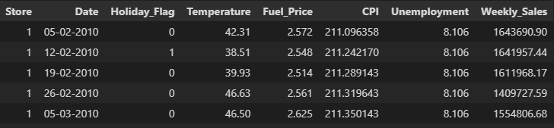
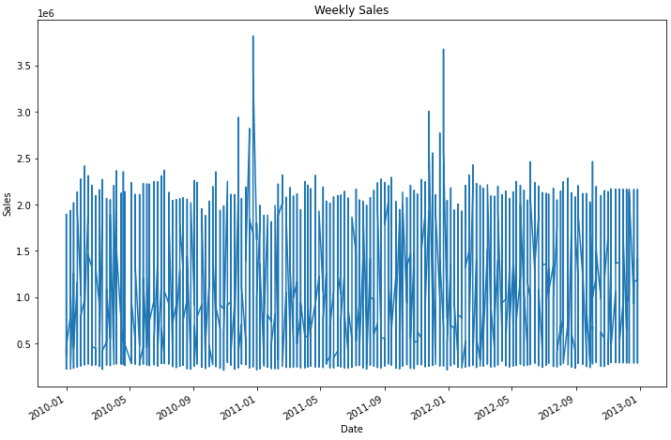
Project analysis slide 6
Dataset details
Dataset contains 8 features and 6435 rows
The target feature is WEEKLY SALES
Dataset is about weekly sales of Walmart stores between 2010 and 2013
It represents data for 45 stores

Slide 6
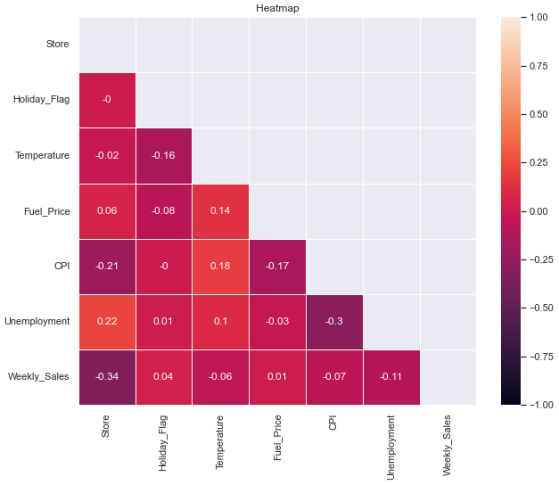
Project analysis slide 5
Heatmap
Low level of correlated features with target
The more correlated features are “Holiday_Flag” and “Fuel Price”

Slide 7
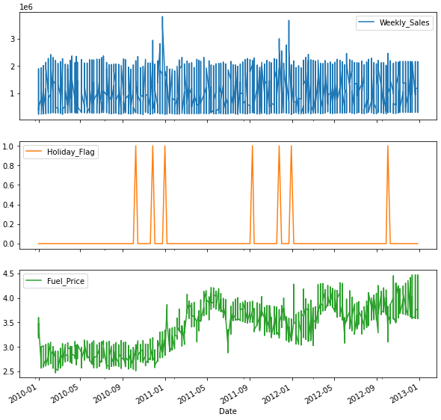
Project analysis slide 5
Target feature
Target feature with the more correlated features

Slide 8
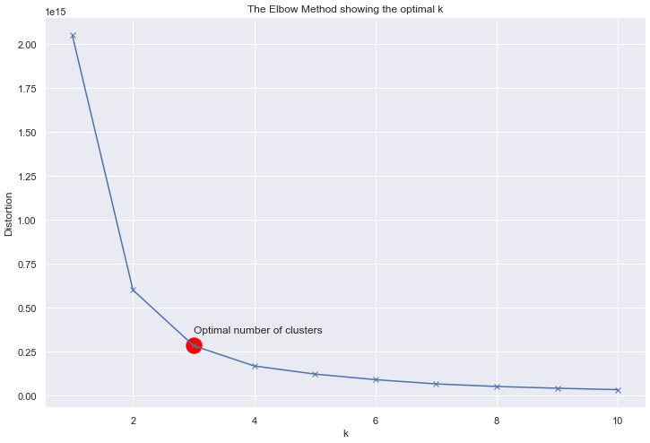
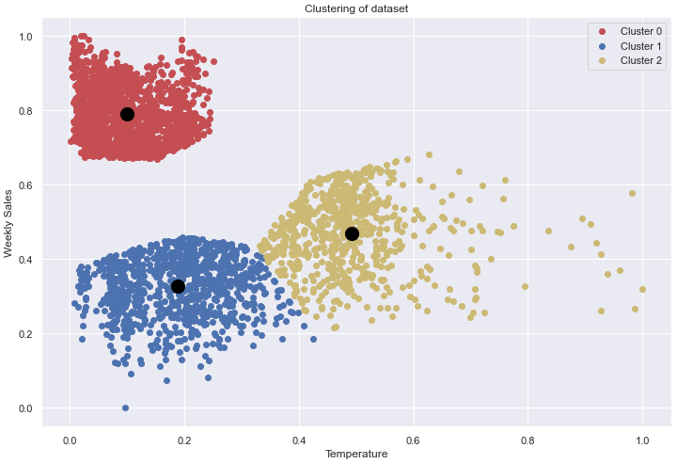
Project analysis slide 5
Data clusterization
Determining the best number of clusters
Plotting clusters on scatter plot

Slide 9
Thank You

